Slide 1
MCDA 5550 - Web App Development Chapter 7. Graphics on HTML5 Canvas
Instructor: Dinesh kg

Slide 2
HTML5 <canvas>
New to HTML5
<canvas> used to draw graphics on the fly using JavaScript
Only a container for graphics – need to use a script to draw the graphics.
Canvas is associated with several functions for drawing paths, boxes, circles, text, and adding images

Slide 3
html
Always specify an id, and a width and height attribute to define the size of the canvas.
<!DOCTYPE html>
<html>
<head>
<script src="scripts/canvasIntro.js" type="text/javascript“ ></script>
</script>
</head>
<body onload="draw();">
<canvas id="canvasElement" height="250" width="250"></canvas>
</body>
</html>

Slide 4
js
getContext(“2d”) returns an object that can be used to execute drawing functions
We only use “2d” for now
function draw()
{
var canvas = document.getElementById("canvasElement");
var canvasContext = canvas.getContext("2d");
drawLine(canvasContext, 50, 50, 200, 80);
drawCircle(canvasContext, 125, 125, 50);
}

Slide 5
Cont’d…
beginPath()
begins a new path or resets the current path.
First, create a path, using moveTo(), lineTo(), quadricCurveTo(), arcTo(),arc() etc.
Then draw using stroke() or fill()
Tip: Use the stroke() method to draw the path on the canvas.
function drawLine(canvasContext, lineStartX, lineStartY, lineEndX, lineEndY)
{
canvasContext.beginPath();
canvasContext.moveTo(lineStartX, lineStartY);
canvasContext.lineTo(lineEndX, lineEndY);
canvasContext.stroke();
}

Slide 6
Canvas coordinate system
(0,0)
X
y

Slide 7
Cont’d…
arc(x, y, radius, start, end)
function drawCircle(canvasContext, centerX, centerY, radius)
{
var startAngleInRadians=0;
var endAngleInRadians=2*Math.PI;
canvasContext.beginPath();
canvasContext.arc(centerX, centerY, radius, startAngleInRadians, endAngleInRadians);
canvasContext.stroke();
}

Slide 8
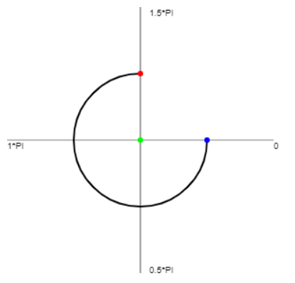
Canvas coordinate system

Slide 9
Attributes of strokes/fill
strokeStyle – color spec
ctx.strokeStyle="#f0000";
lineWidth – how thick the line should be
ctx.lineWidth=5;
fillStyle – color spec
ctx.fillStyle = “#00ff00”;

Slide 10
Gradient (linear)
createLinearGradient(x0,y0,x1,y1)
x0: The x-coordinate of the start point of the gradient
y0 : The y-coordinate of the start point of the gradient
x1 : The x-coordinate of the end point of the gradient
y1 : The y-coordinate of the end point of the gradient
addColorStop(stop, color)
Adds colors for key stop locations
stop: A value between 0.0 and 1.0 that represents the position between start and end in a gradient
color: A CSS color value to display at the stop position

Slide 11
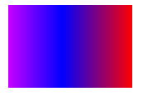
Gradient (linear)
var gradient=canvasContext.createLinearGradient(0,0,170,0);
gradient.addColorStop("0","magenta");
gradient.addColorStop("0.5","blue");
gradient.addColorStop("1.0","red");
// Fill with gradient
canvasContext.fillStyle=gradient;
canvasContext.fillRect(20,20,150,100);

Slide 12
Gradient (radial)
createRadialGradient(x0,x1,r0,x1,y1,r1)
x0 The x-coordinate of the starting circle of the gradient
y0 The y-coordinate of the starting circle of the gradient
r0 The radius of the starting circle
x1 The x-coordinate of the ending circle of the gradient
y1 The y-coordinate of the ending circle of the gradient
r1 The radius of the ending circle

Slide 13
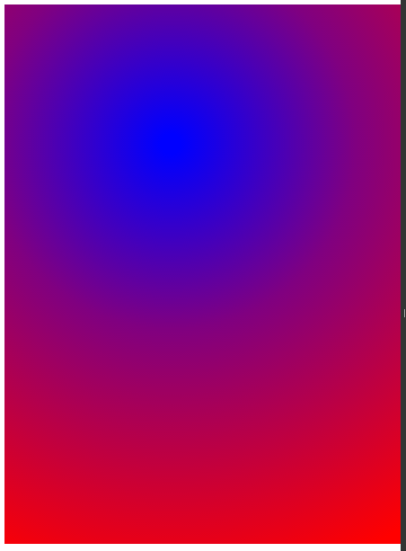
Gradient (radial)
var rGradient=ctx.createRadialGradient(185,155,10,185,155,500);
rGradient.addColorStop("0","blue");
rGradient.addColorStop("0.4","purple");
rGradient.addColorStop("1.0","red");
ctx.fillStyle = rGradient;
ctx.fillRect(0,0,600,600);

Slide 14

Shadows
shadowBlur: blur level
shadowColor: color spec, can use #rrggff
shadowOffsetX/shadowOffsetY
default is no offset (0, 0)
ctx.shadowBlur=30;
ctx.shadowColor="red";
ctx.shadowOffsetX = 10;
ctx.shadowOffsetY = 30;
ctx.fillRect(20,20,150,100);

Slide 15
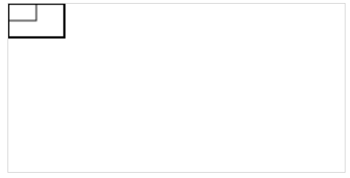
Scale
Scales (anchored at the origin)
ctx.strokeRect(0, 0, 25, 15);
ctx.scale(2, 2);
ctx.strokeRect(0, 0, 25, 15);

Slide 16
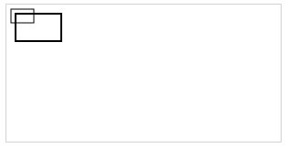
Scale
Scales (not anchored at the origin)
ctx.strokeRect(5, 5, 25, 15);
ctx.scale(2, 2);
ctx.strokeRect(5, 5, 25, 15);

Slide 17
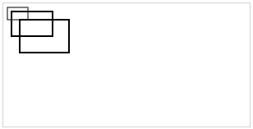
Scale
Once it’s applied, all future drawings will also be affected.
ctx.strokeRect(5, 5, 25, 15);
ctx.scale(2, 2);
ctx.strokeRect(5, 5, 25, 15);
ctx.strokeRect(10, 10, 30, 20);

Slide 18
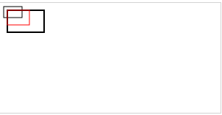
Scale
If you want to scale a specific shape, then you’ll need to scale it back:
ctx.strokeRect(5, 5, 25, 15);
ctx.scale(2, 2);
ctx.strokeRect(5, 5, 25, 15);
ctx.scale(0.5, 0.5);
ctx.strokeStyle = "red";
ctx.strokeRect(10, 10, 30, 20);

Slide 19
Or use save() and restore()
ctx.strokeRect(5,5,25,15);
ctx.save(); //save the current state
ctx.scale(2,2);
ctx.strokeRect(5,5,25,15);
ctx.restore();//restore the saved state
ctx.strokeStyle = "red";
ctx.strokeRect(10,10,30,20);

Slide 20
Rotate
rotate(angle) rotates the coordinate system (i.e., axes) around the origin by angle (in radians ) :

Slide 21
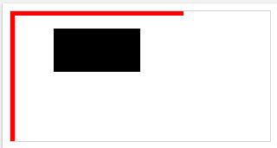
Rotate
Without rotation:
ctx.fillStyle = "red";
ctx.fillRect(0,0,200,5); //x-axis
ctx.fillRect(0,0,5,200); //y-axis
ctx.fillStyle = "black";
ctx.fillRect(50, 20, 100, 50);

Slide 22
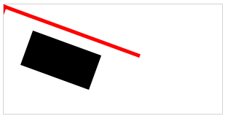
Rotate
With rotation:
ctx.rotate(20 * Math.PI / 180);
ctx.fillStyle = "red";
ctx.fillRect(0,0,200,5); //x-axis
ctx.fillRect(0,0,5,200); //y-axis
ctx.fillStyle = "black";
ctx.fillRect(50, 20, 100, 50);

Slide 23
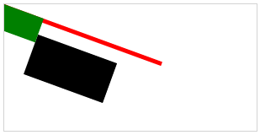
Rotate
All the drawings AFTER rotate() are affected
ctx.rotate(20 * Math.PI / 180);
ctx.fillStyle = "red";
ctx.fillRect(0,0,200,5); //x-axis
ctx.fillRect(0,0,5,200); //y-axis
ctx.fillStyle = "black";
ctx.fillRect(50, 20, 100, 50);
ctx.fillStyle = "green";
ctx.fillRect(0, 0, 50, 30);

Slide 24
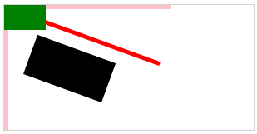
Cont’d…
If you want to rotate only a specific drawing, rotate back (or save and restore) before another one!
ctx.rotate(20 * Math.PI / 180);
ctx.fillStyle = "red";
ctx.fillRect(0,0,200,5);//x-axis
ctx.fillRect(0,0,5,200);//y-axis
ctx.fillStyle = "black";
ctx.fillRect(50, 20, 100, 50);
ctx.rotate(-20 * Math.PI / 180);
ctx.fillStyle = "pink";
ctx.fillRect(0,0,200,5);//x-axis, rotated back
ctx.fillRect(0,0,5,200);//y-axis, rotated back
ctx.fillStyle = "green";
ctx.fillRect(0, 0, 50, 30);

Slide 25
Translate
translate(x,y) moves the coordinate system by x and y.
All the drawings AFTER translate() are affected

Slide 26
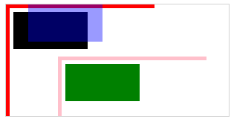
Translate
ctx.fillStyle = "red";
ctx.fillRect(0,0,200,5);//original x-axis
ctx.fillRect(0,0,5,200);//original y-axis
ctx.fillStyle = "black";
ctx.fillRect(10, 10, 100, 50);
//translated rect
ctx.translate(70, 70);
ctx.fillStyle = "pink";
ctx.fillRect(0,0,200,5);//translated x-axis
ctx.fillRect(0,0,5,200);//translated y-axis
ctx.fillStyle = "green";
ctx.fillRect(10, 10, 100, 50);
//bring it back
ctx.translate(-70, -70);
ctx.globalAlpha=0.4;//transparency
ctx.fillStyle = "blue";
ctx.fillRect(30, 0, 100, 50);

Slide 27
When combined…
Can you draw the output of the code?
ctx.globalAlpha=0.9
ctx.translate(100,20);
ctx.rotate(45 *Math.PI/ 180);
ctx.scale(2,2);
ctx.fillStyle = "black";
ctx.fillRect(0,0,200,30);
ctx.scale(0.5,0.5);
ctx.fillStyle = "red";
ctx.fillRect(80,80,200,30);
ctx.rotate(-25 *Math.PI/ 180);
ctx.fillStyle = "green";
ctx.fillRect(0,0,200,30);
ctx.rotate(-20 *Math.PI/ 180);
ctx.translate(-100,-20);
ctx.fillStyle = "pink";
ctx.fillRect(0,0,200,30);

Slide 28
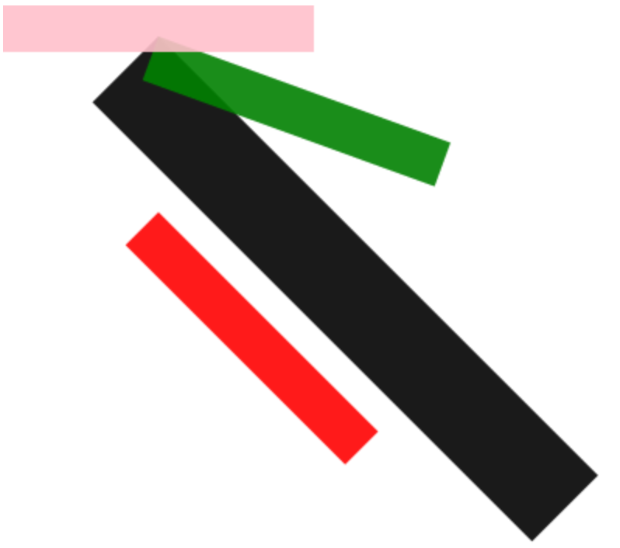

Slide 29
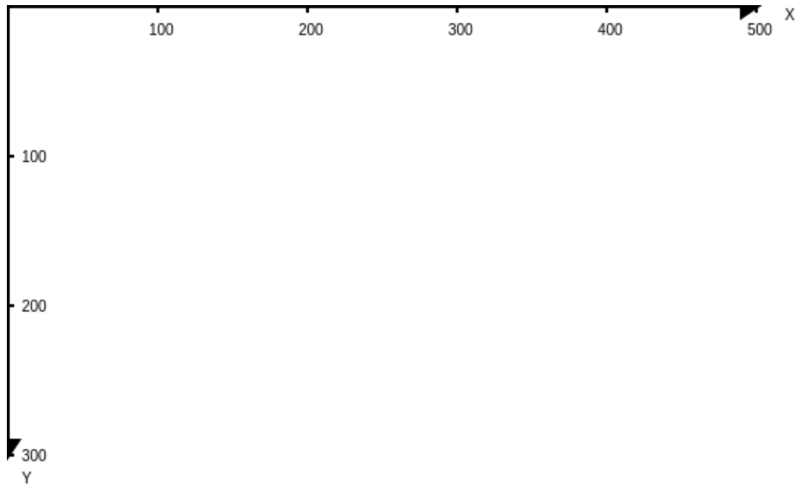
Class Activity - 1
Write a function that draws x-y axes with labels

Slide 30
drawAxes() function
A common technique we use in computer graphics
When we apply a sequence of transformations (rotate, scale, translate), easy to get disoriented (especially in 3D, but in 2D as well)
Displaying axes
i.e., where the origin is currently at in the viewport, and indicates directions of x and y axes

Slide 31
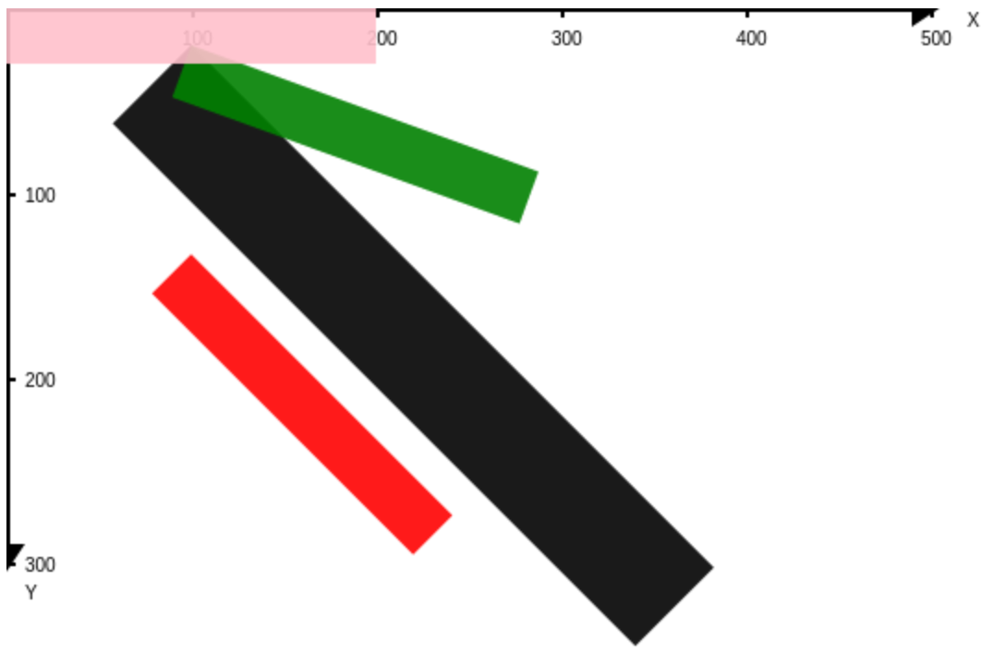
drawAxes() function
Use it to confirm the transformation of the coordinate system!
Before any transformation:
drawAxes(ctx,"black","black",500,300,100);
ctx.globalAlpha=0.9;//opacity
ctx.translate(100,20);
ctx.rotate(45 *Math.PI/ 180);
ctx.scale(2,2);
ctx.fillStyle = "black";
ctx.fillRect(0,0,200,30);
…..

Slide 32
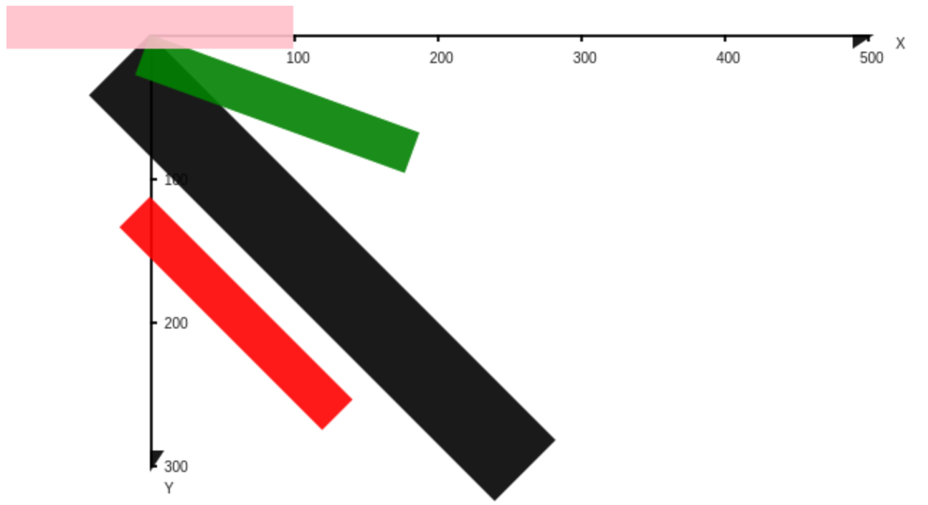
drawAxes() function
After the 1st translation:
ctx.globalAlpha=0.9;// opacity
ctx.translate(100,20);
drawAxes(ctx,"black","black",500,300,100);
ctx.rotate(45 *Math.PI/ 180);
ctx.scale(2,2);
ctx.fillStyle = "black";
ctx.fillRect(0,0,200,30);
…

Slide 33
function drawAxes(ctx, xColor, yColor, maxX, maxY, labelStep){
//x-axis
ctx.fillStyle = xColor;
ctx.fillRect(0,0,maxX,2);
//arrow head
ctx.beginPath();
ctx.moveTo(maxX+5,0);
ctx.lineTo(maxX-10,10);
ctx.lineTo(maxX-10,0);
ctx.closePath();
ctx.fill();
ctx.fillText("X",maxX+20,10);
//labels
for(var stop=labelStep;stop<=maxX;stop+=labelStep){
ctx.fillRect(stop,0,2,5);
ctx.fillText(stop,stop-5,20);
}//end for

Slide 34
//y-axis
ctx.fillStyle = yColor;
ctx.fillRect(0,0,2,maxY);
//arrow head
ctx.beginPath();
ctx.moveTo(0,maxY+5);
ctx.lineTo(10,maxY-10);
ctx.lineTo(0,maxY-10);
ctx.closePath();
ctx.fill();
ctx.fillText("Y",10,maxY+20);
//labels
for(var stop=labelStep;stop<=maxY;stop+=labelStep){
ctx.fillRect(0,stop,5,2);
ctx.fillText(stop,10,stop+5);
}//end for

Slide 35
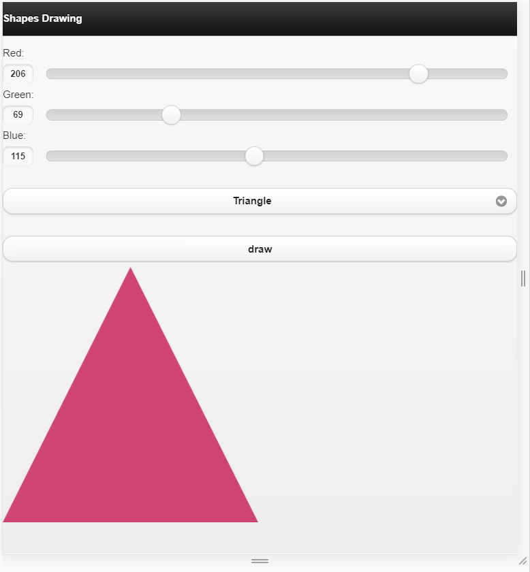
Class Activity -2
Create an app that interactively draws shapes selected by the user, with the specified colors

Slide 36
HTML
RGB range input fields
Color is represented by the combo of red, green, blue
Ranging from 0 to 255 (2⁸-1)
Select with 3 shape options (circle, rectangle, triangle)
Button to render the shape
<label>Red:</label><input type="range" min="0" max="255" step="1" value="0" id="red">
<label>Green:</label><input type="range" min="0" max="255" step="1" value="0" id="green">
<label>Blue:</label><input type="range" min="0" max="255" step="1" value="0" id="blue">
<select id="shape" data-native-menu="false">
<option value="circle">Circle</option>
<option value="rectangle">Rectangle</option>
<option value="triangle">Triangle</option>
</select>
<input type="button" value="draw" id="drawButton">
<canvas id="canvasElement" height="300" width="300">
</canvas>
<script type="text/javascript“ src="scripts/interactiveDrawing.js"></script>

Slide 37
JavaScript
Get values from the elements
var canvas = document.getElementById("canvasElement");//get the element
var ctx = canvas.getContext("2d");//get the context
var r = parseInt($('#red').val());//red value
var g = parseInt($('#green').val()); //green value
var b = parseInt($('#blue').val());// blue value
var w = $('#canvasElement').width();
var h = $('#canvasElement').height();

Slide 38
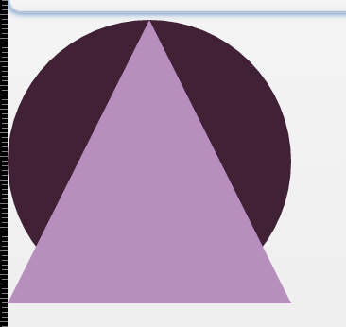
Cont’d…
First, you need to clear the canvas!
Otherwise, the previous shapes will appear
css color specs:
Predefined names: “red”, “black”
Hex: “#ff000000”,”#000000”
rgb: “rgb(255,0,0)”, “rgb(0,0,0)”
(and more…)
//clear
ctx.clearRect(0,0,w,h);
ctx.fillStyle = "rgb(" + r + "," + g + "," + b + ")";

Slide 39
switch() statement in js
Pretty much the same as the Java version
switch(expression) {
case n:
code block
break;
case n:
code block
break;
default:
default code block
}

Slide 40
Cont’d…
Now draw the selected shape
switch ($('#shape').val()) {
case 'circle':
ctx.beginPath();
ctx.arc(w/2, h/2, w/2, 0, 2 * Math.PI);
ctx.fill();
break;
case 'rectangle':
ctx.fillRect(0, 0, w, h);
break;
case 'triangle':
ctx.beginPath();
ctx.moveTo(0,h);
ctx.lineTo(w/2,0);
ctx.lineTo(w,h);
ctx.closePath();
ctx.fill();
}//end switch()

Slide 41
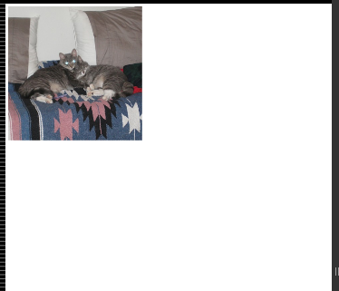
Adding an image file to canvas
You can add an image to the canvas:
ctx.drawImage(img, x, y);
img: image object
x, y: location where the image is placed
var img = new Image(); // Create new img element
img.src = 'cats.jpg'; // Set source path
img.onload = function () {
ctx.drawImage(img,0,0);
};

Slide 42
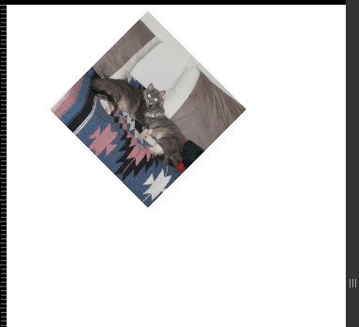
You can apply transformations
var img = new Image(); // Create new img element
img.src = 'cats.jpg'; // Set source path
img.onload = function () {
ctx.translate(400,10);
ctx.rotate(45 * Math.PI/180);
ctx.drawImage(img,0,0);
};

Slide 43
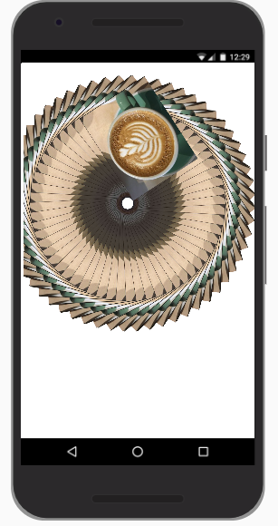
Animation

Slide 44
Cont’d…
<!DOCTYPE HTML> <html> <head> <script type = "text/javascript"> var pattern = new Image(); function animate() { pattern.src = 'img/coffee.jpg’; setInterval(drawShape, 100); } function drawShape() { // get the canvas element using the DOM var canvas = document.getElementById('mycanvas’); // Make sure we don't execute when canvas isn't supported if (canvas.getContext) { // use getContext to use the canvas for drawing
var ctx = canvas.getContext('2d');
ctx.fillStyle = 'rgba(0,0,0,0.4)';
ctx.strokeStyle = 'rgba(0,153,255,0.4)';
ctx.save();
ctx.translate(450,600);
var time = new Date();
ctx.rotate( ((2*Math.PI)/6)*time.getSeconds() + ( (2*Math.PI)/6000)*time.getMilliseconds() );
ctx.translate(0,28.5);
ctx.drawImage(pattern,-3.5,-3.5);
ctx.restore();
} else {
alert('Check your browser!!!.');
}
}
</script>
</head>
<body onload = "animate();">
<canvas id = "mycanvas" width = "1000" height = "1200"></canvas>
</body>
</html>

Slide 45
RGraph package
Some drawing can be tedious
Can use some libraries/APIs to bypass complex graphics code
RGraph: http://www.rgraph.net/
Download library (js):
<script src="scripts/RGraph.common.core.js"></script>
<script src="scripts/RGraph.common.dynamic.js"></script>
<script src="scripts/RGraph.common.effects.js"></script>
<script src="scripts/RGraph.line.js"></script>
<script src="scripts/RGraph.cornergauge.js"></script>
<script src="scripts/RGraph.hprogress.js"></script>

Slide 46
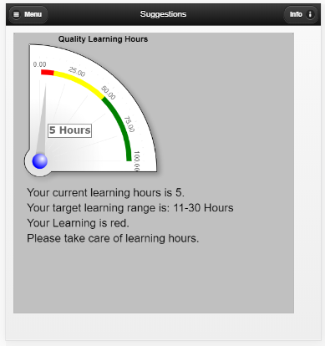
Back to Learning Tracker app
Imagine how tedious to do this only using default canvas functions!

Slide 47
function drawAdviceCanvas(ctx, expense) {
ctx.font = "22px Arial";
ctx.fillStyle = "black";
ctx.fillText("Your current expense is " + expense + ".", 25, 320);
ctx.fillText(
"Your target Expense range is: 50-100CAD", 25, 350);
levelwrite(ctx, expense);
levelMeter(ctx, expense);
}

Slide 48
//For deciding what to write for given values
function levelwrite(ctx, expense) {
if ((expense >= 1) && (expense <= 10)) {
writeAdvice(ctx, "green");
} else if ((expense > 10) && (expense <= 50)) {
writeAdvice(ctx, "yellow");
} else {
writeAdvice(ctx, "red");
}
}
function writeAdvice(ctx, level) {
var adviceLine1 = "";
var adviceLine2 = "";
if (level == "red") {
adviceLine1 = "Please take care of the Expenses.";
adviceLine2 = "Its exceedingly more than set limit.";
} else if (level == "yellow") {
adviceLine1 = "The expenses needs to be checked!!";
} else if (level = "green") {
adviceLine1 =
"Your expenses are on track .";
}
ctx.fillText("Your Expense is " + level +
".", 25, 380);
ctx.fillText(adviceLine1, 25, 410);
ctx.fillText(adviceLine2, 25, 440);
}

Slide 49
RGraph.CornerGauge object
function levelMeter(ctx, expense) {
if (expense <= 100) {
var cg = new RGraph.CornerGauge(
"AdviceCanvas", 0, 100, expense)
.Set("chart.colors.ranges", [
[50, 100, "red"],
[10, 50, "yellow"],
[1, 10, "#0f0"]
]);
} else {
var cg = new RGraph.CornerGauge(
"AdviceCanvas", 0, expense, expense)
.Set("chart.colors.ranges", [
[50, 100, "red"],
[10, 50, "yellow"],
[0.01, 0.1, "#0f0"],
[100.01, expense, "red"]
]);
}
drawMeter(cg);
}

Slide 50
Set properties of RGraph object
// Meter properties
function drawMeter(g) {
g.Set("chart.value.text.units.post", " CAD")
.Set("chart.value.text.boxed", false)
.Set("chart.value.text.size", 14)
.Set("chart.value.text.font", "Verdana")
.Set("chart.value.text.bold", true)
.Set("chart.value.text.decimals", 2)
.Set("chart.shadow.offsetx", 5)
.Set("chart.shadow.offsety", 5)
.Set("chart.scale.decimals", 2)
.Set("chart.title", "Expense Limit")
.Set("chart.radius", 250)
.Set("chart.centerx", 50)
.Set("chart.centery", 250)
.Draw();
}

Slide 51
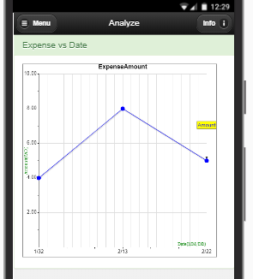
Line Charts
Idea is similar for line charts
Create RGraph object, set properties and draw.

Slide 52
RGraph.Line object
function drawLines(ExpenseArr, expenseUpper, expenseLower, Datearr) {
var expenseLine = new RGraph.Line("GraphCanvas", ExpenseArr, 0, 0)
.Set("labels", Datearr)
.Set("colors", ["blue"])
.Set("shadow", true)
.Set("shadow.offsetx", 1)
.Set("shadow.offsety", 1)
.Set("linewidth", 1)
.Set("numxticks", 6)
.Set("scale.decimals", 2)
.Set("xaxispos", "bottom")
.Set("gutter.left", 40)
.Set("tickmarks", "filledcircle")
.Set("ticksize", 5)
.Set("chart.labels.ingraph", [, , ["Amount",
"blue", "yellow", 1, 80
], , ])
.Set("chart.title", "ExpenseAmount")
.Draw();
}

Slide 53
Manifest file
Downloadable web-based app
Specifies which files need to be downloaded to a local drive
Referenced in the <html> tag
Application Cache (AppCache) interface to specify resources that the browser should cache and make available to offline users
<!DOCTYPE html>
<html lang=en manifest="manifest.appcache">
<head>
….

Slide 54
Files
CACHE MANIFEST
#version 1
index.html
css/bootstrap.css
css/bootstrap.min.css
css/jquery.mobile-1.3.1.min.css
css/images/ajax-loader.gif
css/images/icons-18-white.png
css/images/Thumbs.db
scripts/bootstrap.js
scripts/jquery-1.9.1.min.js
scripts/jquery.mobile-1.3.1.min.js
scripts/RGraph.common.core.js
scripts/RGraph.common.dynamic.js
scripts/RGraph.common.effects.js
scripts/RGraph.cornergauge.js
scripts/RGraph.hprogress.js
scripts/RGraph.line.js
scripts/index.js

Slide 55
Project 1
Fully functioning Learning tracker App (With graphs)
Refer slides to find answer for your queries
Use HelperFunctionsProject1 and Project 1 Files from brightspace
Due Date : June 16th 2019, 11.59 pm

